Slide 1

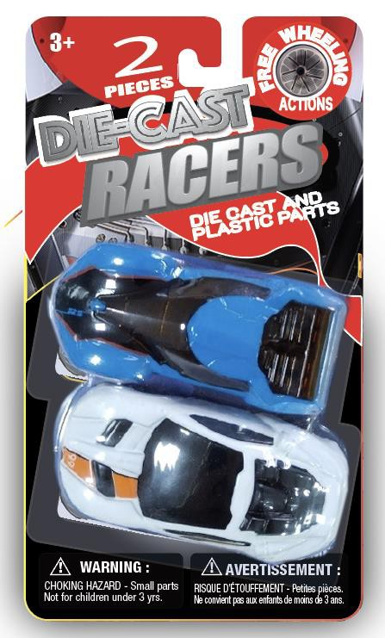
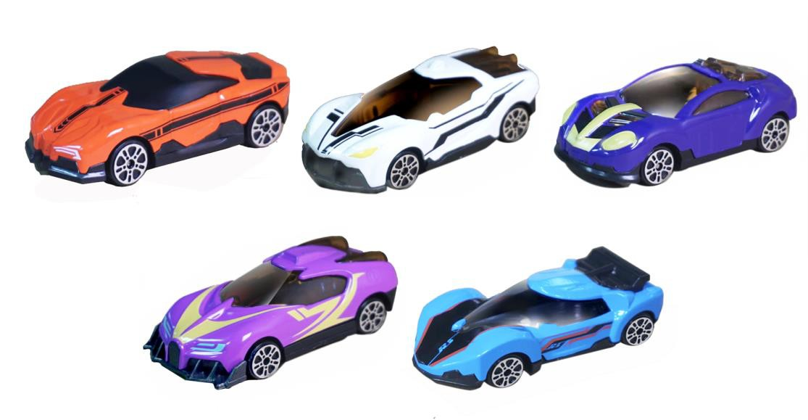
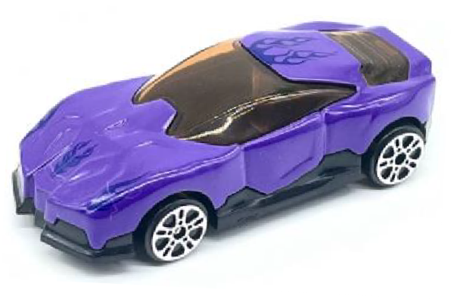
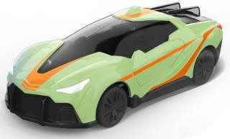
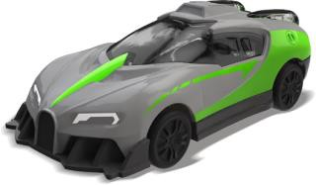
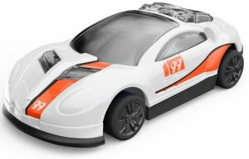
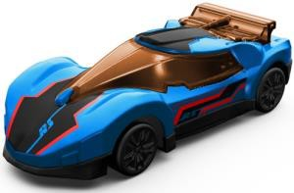
ITEM NO: 3001A-A-Z2-24
2.75” DIECAST CAR – 2 PIECES PACK
Die Cast Cab with Plastic Parts Free Wheeling
BLISTER CARD
SIZE: 3.625” X 0.95” X 6.5”

Slide 2
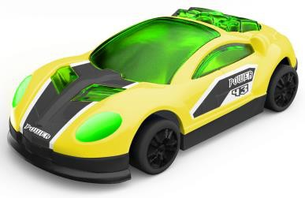
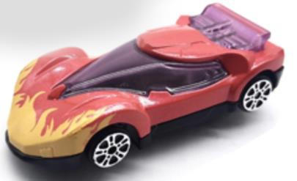
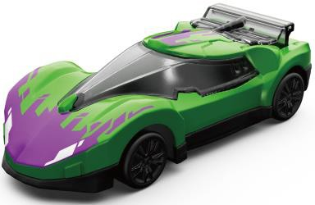
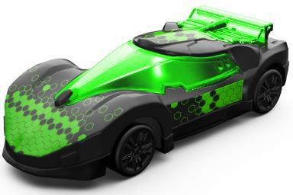
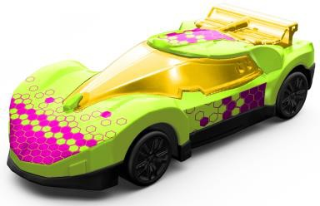
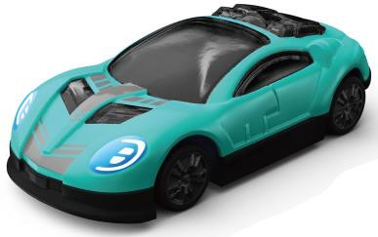
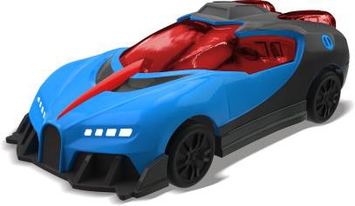
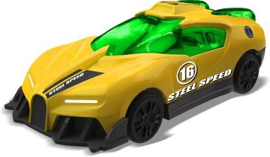
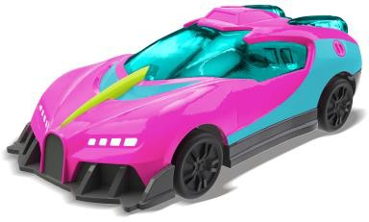
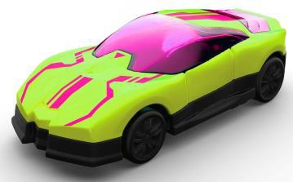
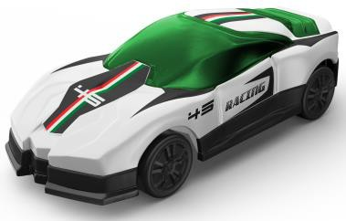
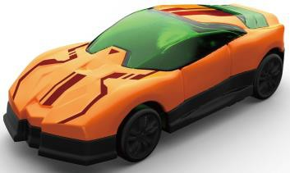
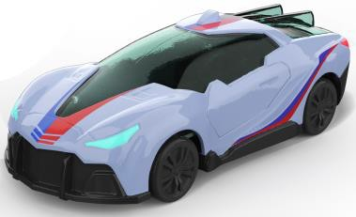
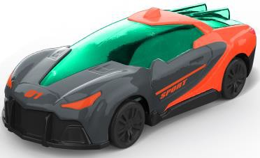
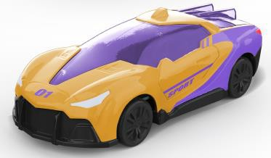
2.New deco ready to ship (15 new color)
BLISTER CARD
SIZE: 3.625” X 0.95” X 6.5”

Slide 3
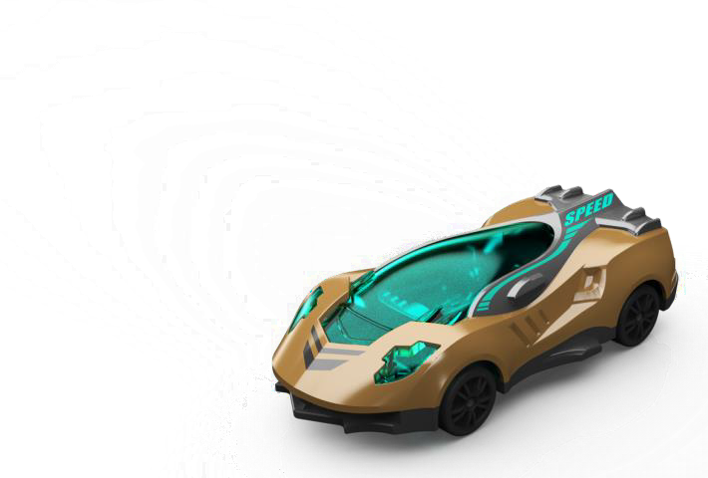
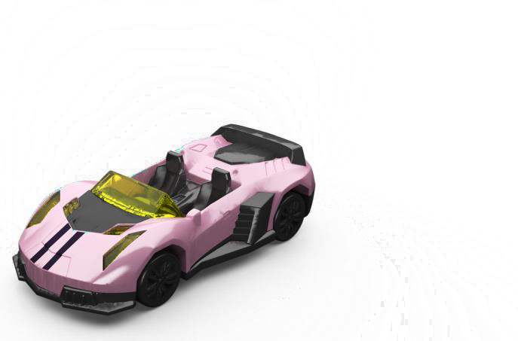
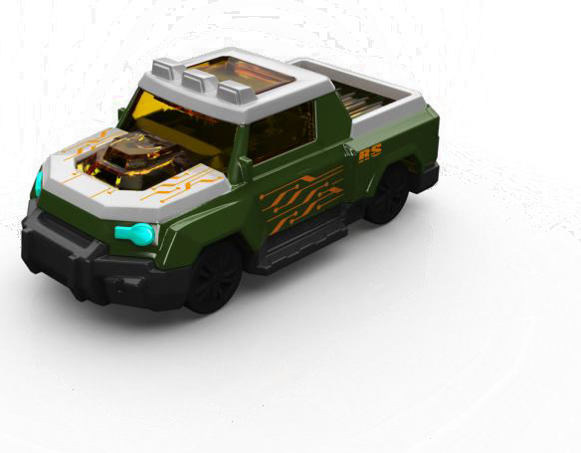
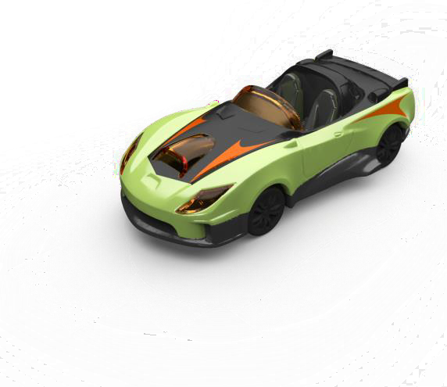
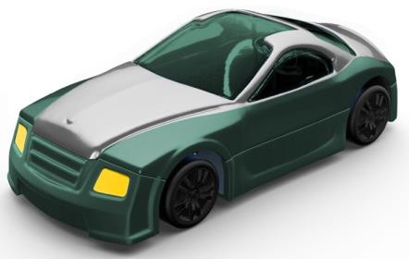
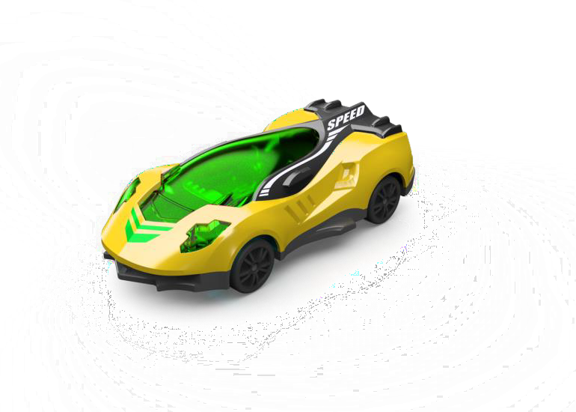
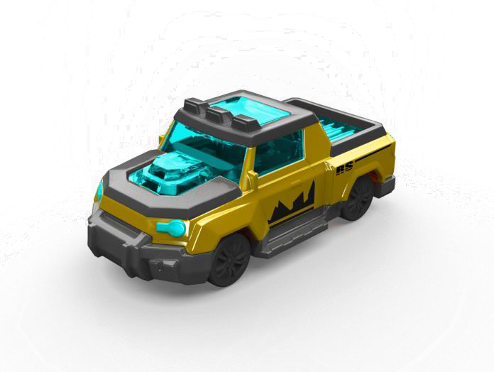
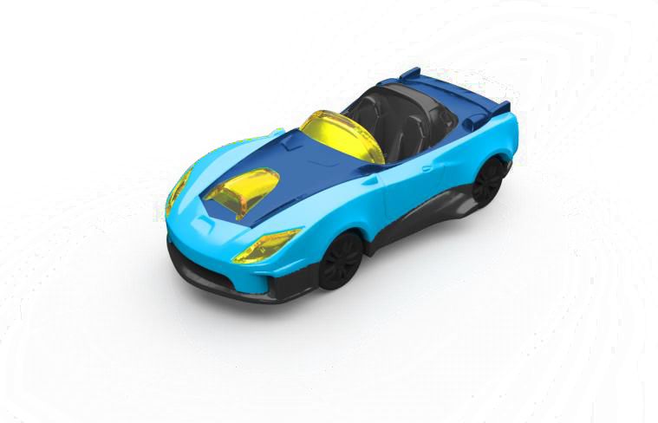
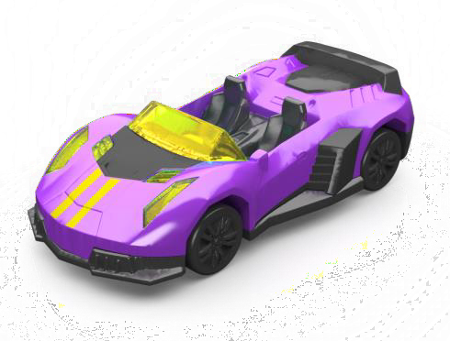
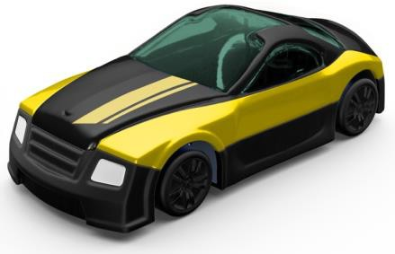
3.New car bodies (Added 5 styles x 2 color) PSD TBD
BLISTER CARD
SIZE: 3.625” X 0.95” X 6.5”

Slide 4
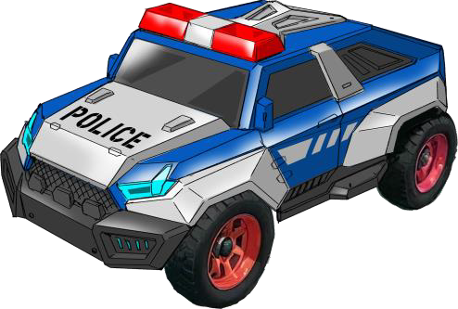
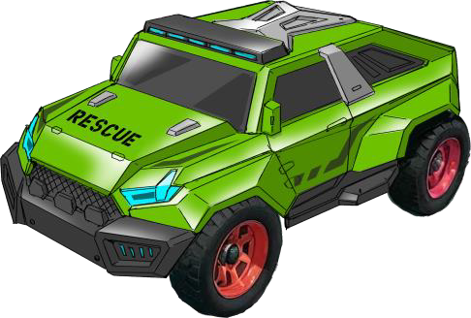
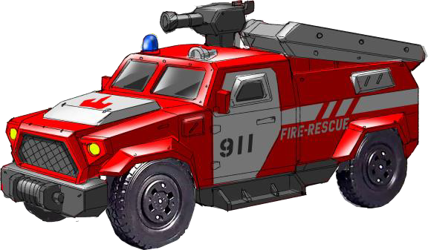

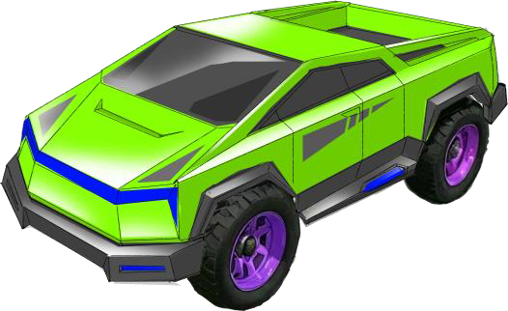
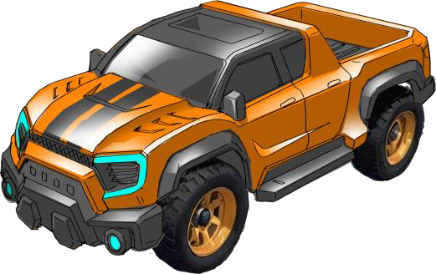
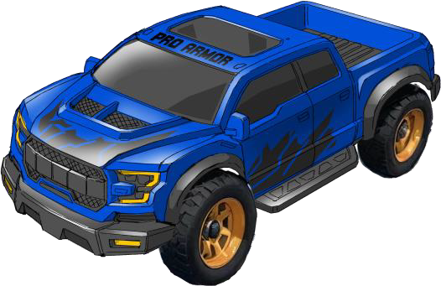
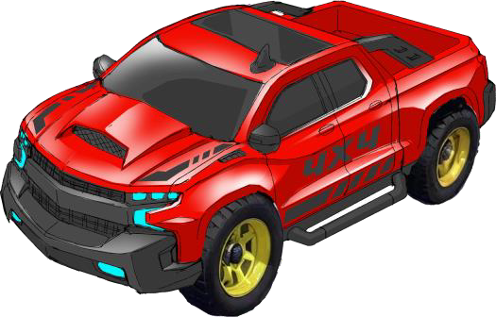
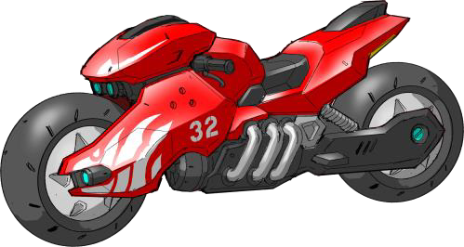
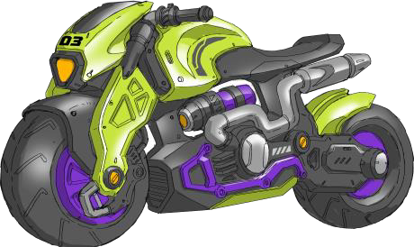
School Bus
SUV (Police)
SUV
Fire Truck
Pick up
Pick up
Pick Up (F150)
Pick Up (Chevy)
BLISTER CARD
SIZE: 3.625” X 0.95” X 6.5”
Motorcycle
Motorcycle

Slide 5
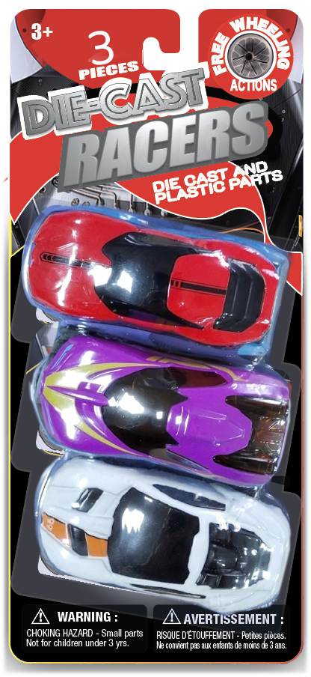

ITEM NO: 3001A-A-Z3-24
2.75” DIECAST CAR – 3 PIECES PACK
Die Cast Cab with Plastic Parts Free Wheeling
BLISTER CARD
SIZE: 3.625” X 0.95” X 7.5”

Slide 6

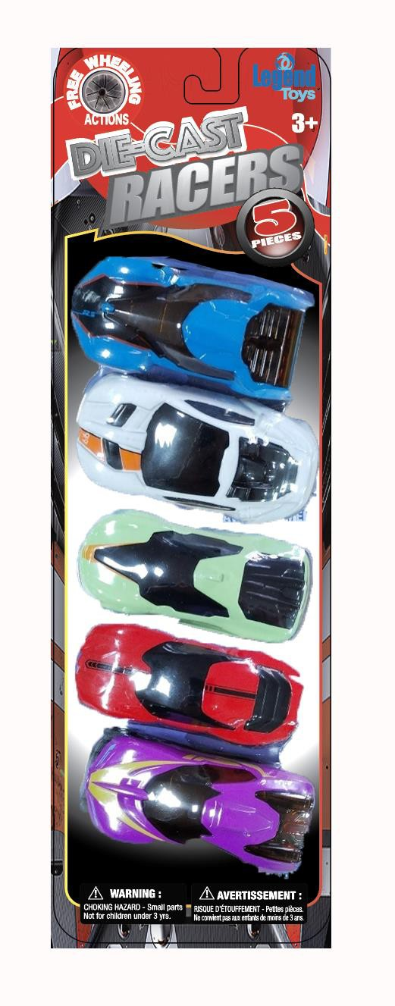
ITEM NO: 3001A-A-Z5-24
2.75” DIECAST CAR – 5 PIECES PACK
Die Cast Cab with Plastic Parts Free Wheeling
Blister Card
SIZE: 4” X 1.5” X 9”

Slide 7
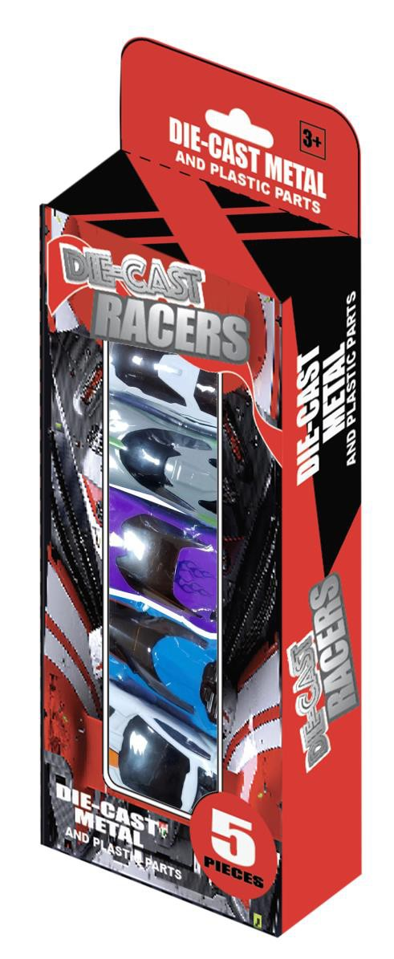
ITEM NO: 3001A-A-W5-24
2.75” DIECAST CAR – 5 PIECES PACK
Die Cast Cab with Plastic Parts Free Wheeling
WINDOW BOX
SIZE: 4” X 1.5” X 9”

Slide 8
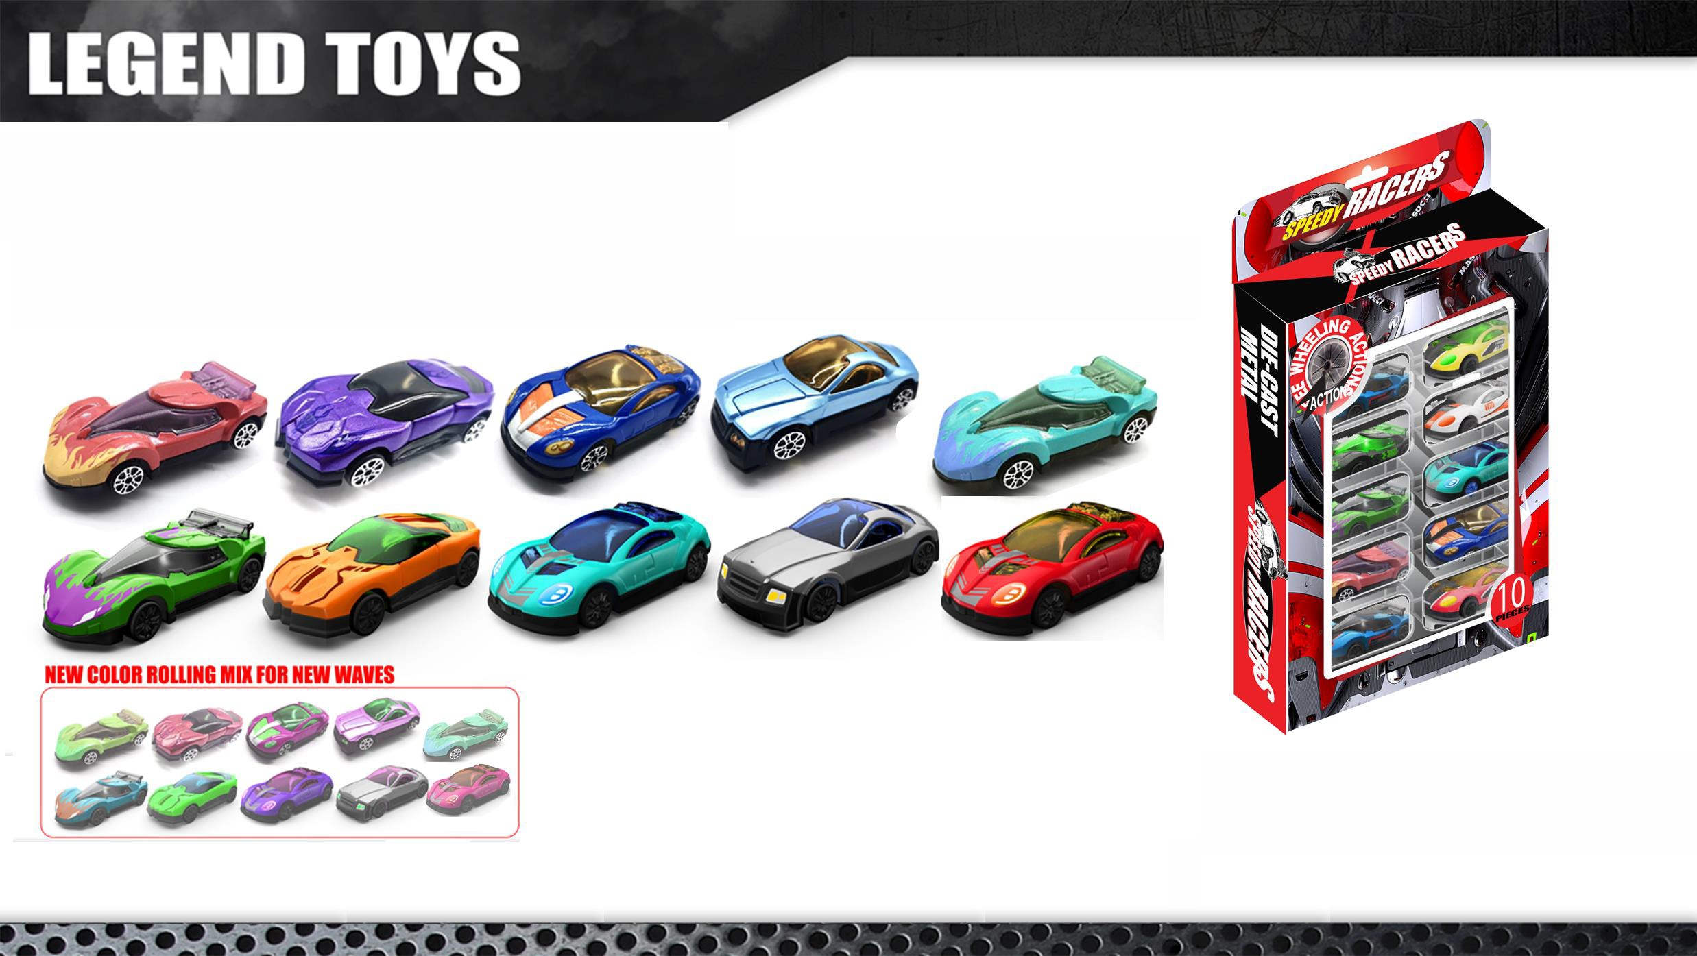
ITEM NO: 3001A-A-W10-24
2.75” DIECAST CAR – 10 PIECES PACK
Die Cast Cab with Plastic Parts. • Free Wheeling
WINDOW BOX
SIZE: 7” X 9” X 1.75”

Slide 9
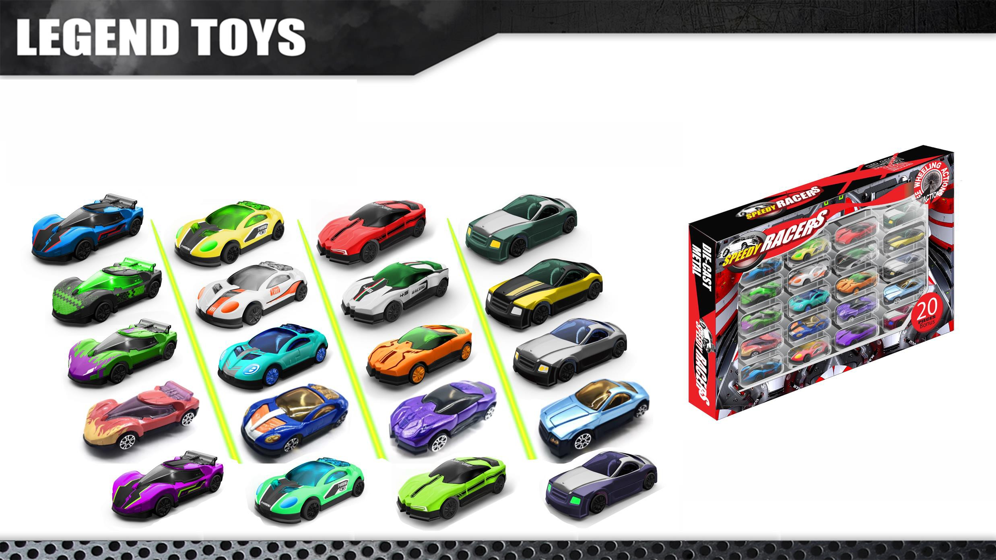
ITEM NO: 3001A-A-W20-24
2.75” DIECAST CAR – 20 PIECES PACK
Die Cast Cab with Plastic Parts. • Free Wheeling
WINDOW BOX
SIZE: 14.25” X 1.5 ” X 9”

Slide 10
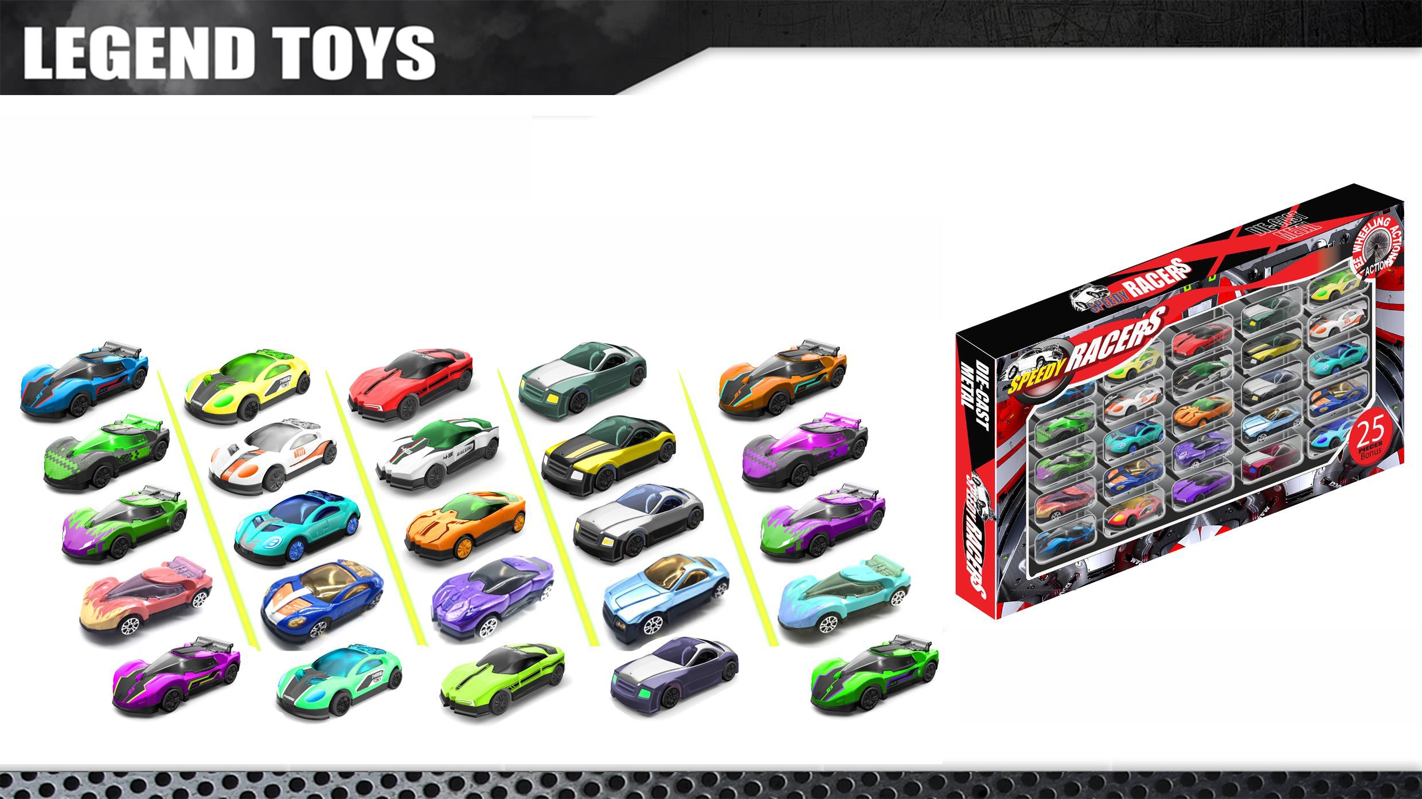
ITEM NO: 3001A-A-W25-12
2.75” DIECAST CAR – 25 PIECES PACK
Die Cast Cab with Plastic Parts. • Free Wheeling
WINDOW BOX
SIZE: 17.75” X 1.5 ” X 9”

Slide 11
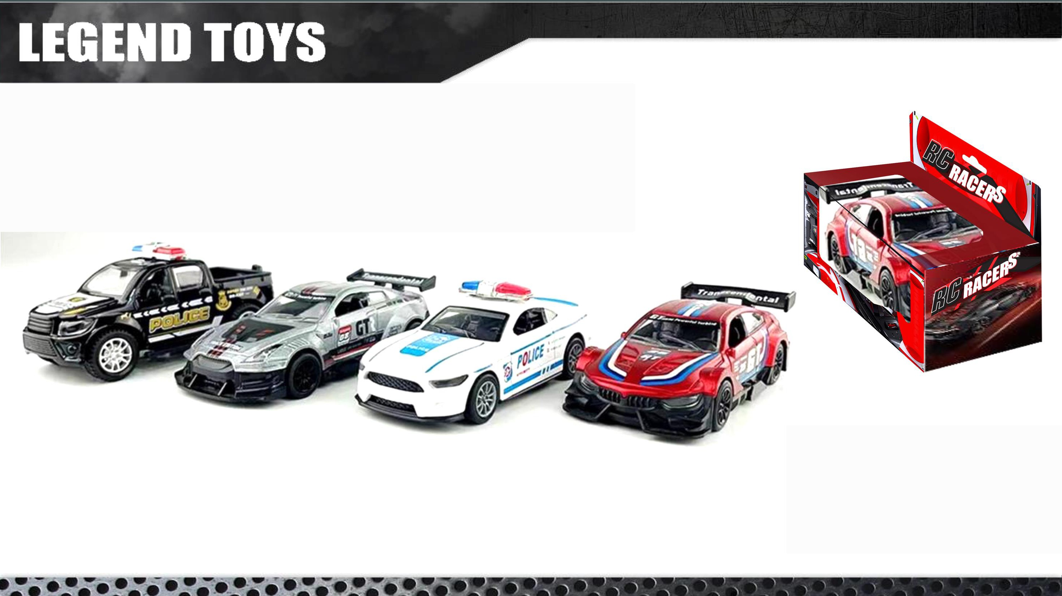
ITEM NO: 3066A-A-W-12
LNS 4.3” PULL BACK PLASTIC CAR ASST.
PULL BACK ACTION WITH AUTHENTIC DECORATION
WINDOW BOX
SIZE: 6” X 2.5” X 5”

Slide 12
ITEM NO: 3014A-A-W-12
LNS 4.3” PULL BACK DIECAST CAR ASST.
PULL BACK ACTION WITH AUTHENTIC DECORATION
WINDOW BOX
SIZE: 6” X 2.5” X 5”

Slide 13

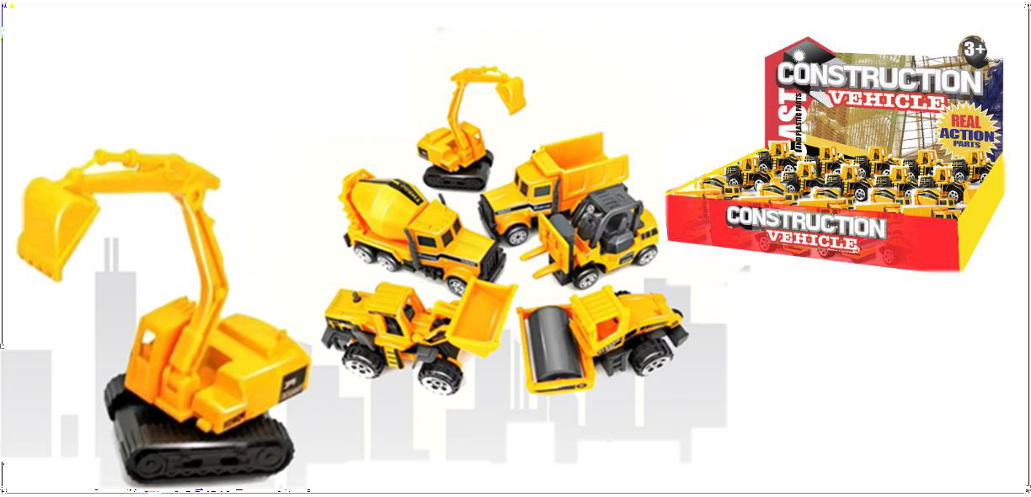
LEGEND TOYS
ITEM No. :3023A-A-A-X-24
3” CONSTRUCTION TRUCKS WITH MOVABLE
PARTS
CDU BOX:
SIZE: 19.68” x 5.9” x 1.77”

Slide 14
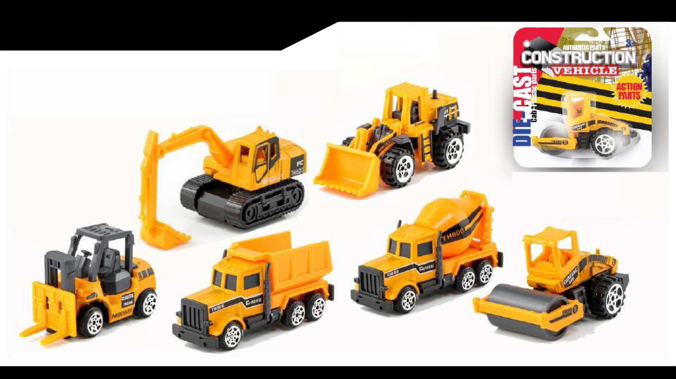
LEGEND TOYS
ITEM NO: 3023A-A-Z-24
3” CONSTRUCTION TRUCK
Die Cast Cab with Plastic Movable Parts Free Wheeling 4 Vehicles + 10 Road Sign
BLISTER CARD
SIZE: 5” X 5” X 2”

Slide 15



ITEM No. :3023A-A-W3-24
3” CONSTRUCTION TRUCKS WITH MOVABLE
PARTS
3-PIECE-PACK
Window Box with Header:
SIZE: 3.74” x 1.8” x 7.28”

Slide 16
ITEM No. :3023A-A-W4-24
3” CONSTRUCTION TRUCKS WITH MOVABLE
PARTS
4-PIECE-PACK
Window Box with Header:
SIZE: 3.74” x 1.8” x 7.28”

Slide 17

ITEM No. :3023A-A-W5-24
3” CONSTRUCTION TRUCKS WITH MOVABLE
PARTS
5-PIECE-PACK
Window Box with Header:
SIZE: 5.1” x 1.8” x 9”

Slide 18

ITEM NO: 3061-W3-12
3 HEAVY TRUCK PLAYSET
FREE WHEELING with MOVABLE PARTS
Consist of 1 Crank Truck, 1 Cement Mixer and 1 Hydraulic Shovel
Window BOX
SIZE: 6.625” X 2.25” X 11.375”

Slide 19





ITEM NO: 3072A-A-O-12 LnS HEAVY TRUCK ASST.
Light and Engine Sound with Movable Parts
OPEN BOX
SIZE: 10” X 5.5” X 6.25”

Slide 20

ITEM NO: 3062-W5-6
3 HEAVY TRUCKS AND 2 LORRIES
FREE WHEELING with MOVABLE PARTS
Consist of 1 Crank Truck, 1 Bull Dozer, 1 Dump Truck, 1 Oil Tanker and 1 Cement Mixer
WINDOW BOX
SIZE: 16” X 2.5” X 7.5”

Slide 21

ITEM NO: 3065-O-6
LNS HEAVY TRUCK PLAYSET
Light and Engine Sound with Movable Parts
Consist of 1 heavy truck, 1 Posable Figure with a Stand, 3 Tools and 5 Road Sign
OPEN BOX
SIZE: 13.5” X 5.5” X 6.25”

Slide 22
ITEM NO: 3058A-W4-6
3.5” CONSTRUCTION TRUCK PLAYSET
Die Cast Cab with Plastic Movable Parts Free Wheeling 4 Vehicles + 10 Road Sign
WINDOW BOX
SIZE: 16” X 1.75” X 5.25”

Slide 23

ITEM NO: 3060-A-O-2
2.4G FULL FUNCTION R/C CAR
BATTERY OPERATED
WINDOW BOX
SIZE: 16” X 1.75” X 5.25”

Slide 24

ITEM NO: 3045-A-O-2
15” 2.4G FULL FUNCTION R/C CAR
FOR 11.5” DOLLS
SPARKLING DECORATION
OPEN BOX
SIZE: 17.5” X7.66” X 6.75”
BATTERY OPERATED

Slide 25


Slide 26

ITEM No. : 3011-A-O-12
Deluxe Tool Belt Set
Open Box with Blister:
15.74” x 9.84” x 2.36”

Slide 27

ITEM NO: 3026-A-A-Y-4 LNS KITCHEN SET & SHOPPING CHECKOUT COUNTER SET W/.
ACCESSORIES
BATTERY OPERATED
OPEN BOX
SIZE: 17.75” X 6.25” X 19.5”

